Slide 1


Slide 2
Please sign the registration
pad located at the
end of each row.

Slide 3
Mission Statement
“We are united to love God,
to grow in our commitment to Christ,
to serve others,
and welcome all people.”

Slide 6
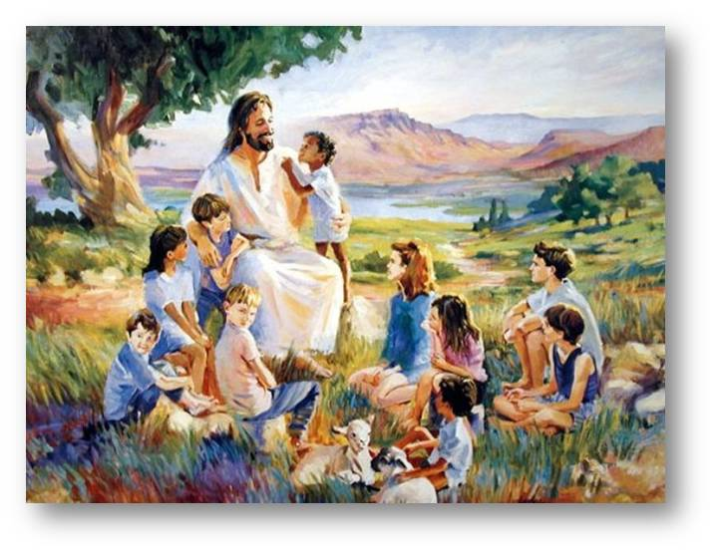
Children’s Message

Slide 7

Scripture Reading
Matthew 16:21-28

Slide 8
21-From that time on, Jesus began to show his disciples that he must fo to Jerusalem and undergo great suffering at the hands of the elders and chief priests and scribes, and be killed, and on the third day be raised.

Slide 9
22- And Peter took him aside and began to rebuke him, “God forbid it Lord! This must never happen to You.”
And after he dismissed the crowds, he went up the mountain by himself to pray. When evening came, he was

Slide 10
23-But he turned and said to Peter,” Get behind me, Satan! You are a stumbling block to me; for you are setting your mind not on divine things but on human things.”

Slide 11
24- Then Jesus told his disciples, “ If any want to become my followers, let them deny themselves and take up their cross and follow me.

Slide 12
25- For those who want to save their life will lose it, and those who lose their life for my sake will find it

Slide 13
26- For what will it profit them if they gain the whole world but forfeit their life?

Slide 14
27- For the Son of man is to come with his angels in the glory of his Father, and then he will repay everyone for what has been done.

Slide 15
28- Truly I tell you, there are some standing here who will not taste death before they see the Son of Man coming in his kingdom.”

Slide 16
This is the Word of God
for the people of God.
Thanks be to God!

Slide 17

Message
“Lose It And Use It”

Slide 18

Pastoral
Prayer

Slide 19
The Lord’s Prayer
Our Father, who art in heaven, hallowed be thy name.
Thy Kingdom come, thy will be done, on earth as it is in heaven.

Slide 20
Give us this day our daily bread.
And forgive us our trespasses, as we forgive those who trespass against us.

Slide 21
And lead us not into temptation, but deliver us from evil.
For thine is the kingdom, and the power and the glory, forever. Amen.

Slide 23


Slide 24
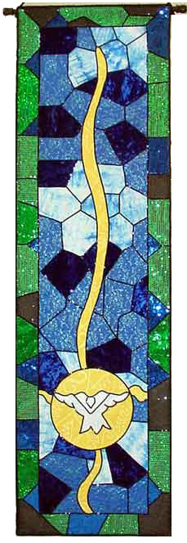
God Be with You till We Meet Again
(1)
“God Be With You
Till We Meet Again”
God be with you
till we meet again;
by his counsels guide,
uphold you,
with his sheep
securely fold you;
God be with you
till we meet again.

Slide 25
Till we meet,
till we meet,
till we meet
at Jesus’ feet;
till we meet,
till we meet,
God be with you
till we meet again.
CCLI #2224700

Slide 26
Go…and make
a difference
for Jesus.

